Slide 1
Lecture 8 Curve Fitting: Interpolation
CSE 2207
Numerical Methods

Slide 2
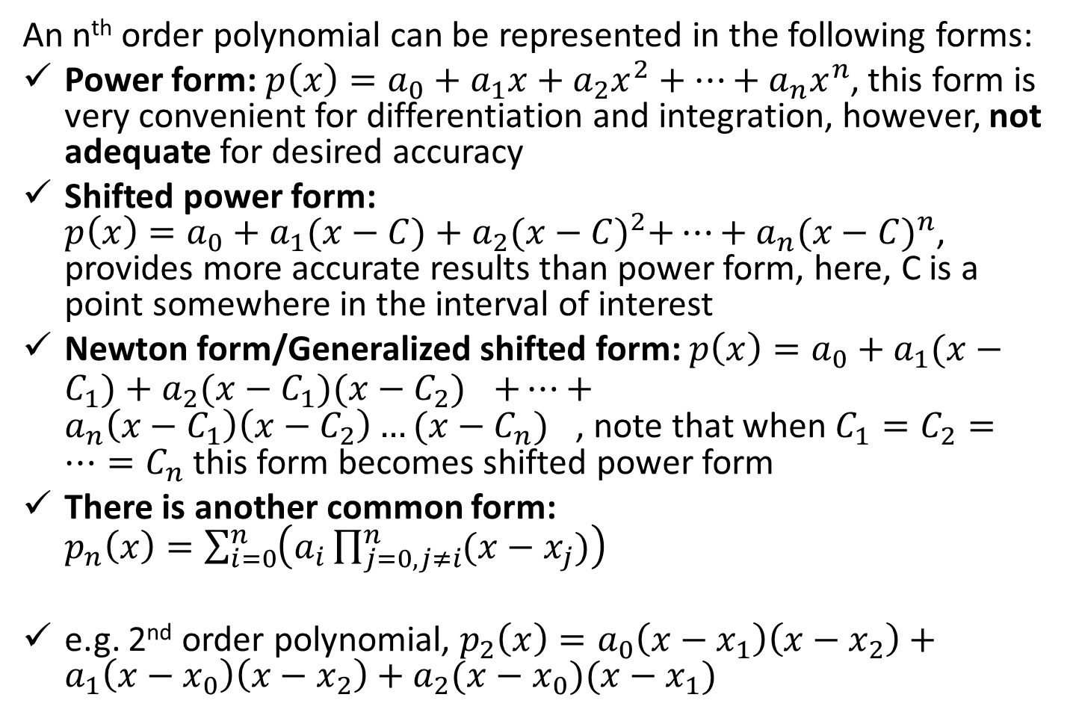
Different forms of n^{th} order Polynomial
An n^{th} order polynomial can be represented in the following forms:
Power form: $p\left(x\right)=a_{0}+a_{1}x+a_{2}x^{2}+…+a_{n}x^{n}$, this form is very convenient for differentiation and integration, however, not adequate for desired accuracy
Shifted power form: $p\left(x\right)=a_{0}+a_{1}(x−C)+a_{2}{(x−C)}^{2}+…+a_{n}{(x−C)}^{n}$, provides more accurate results than power form, here, C is a point somewhere in the interval of interest
Newton form/Generalized shifted form: $p\left(x\right)=a_{0}+a_{1}(x−C_{1})+a_{2}(x−C_{1}){(x−C_{2})}^{}+…+a_{n}{\left(x−C_{1}\right)\left(x−C_{2}\right)…(x−C_{n})}^{}$, note that when $C_{1}=C_{2}=…=C_{n}$ this form becomes shifted power form
There is another common form: $p_{n}\left(x\right)=\sum_{i=0}^{n}{\left(a_{i}\prod_{j=0,j≠i}^{n}{(x−x_{j})}\right)}$
e.g. 2nd order polynomial, $p_{2}\left(x\right)=a_{0}\left(x−x_{1}\right)\left(x−x_{2}\right)+a_{1}\left(x−x_{0}\right)\left(x−x_{2}\right)+a_{2}(x−x_{0})(x−x_{1})$

Slide 3

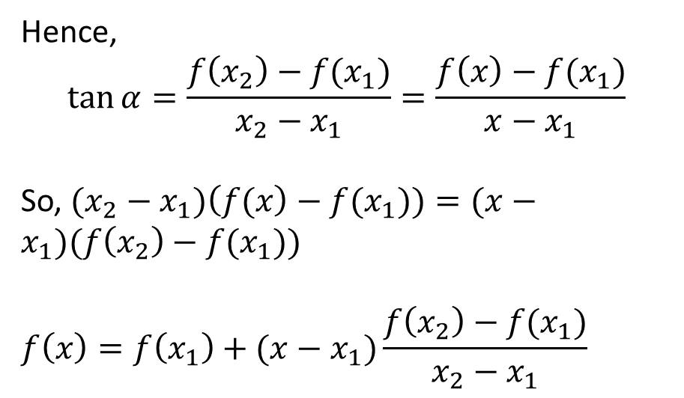

Linear Interpolation
This is the simplest form of interpolation
Construct a function $y(x)$ by joining two given data points
Hence,
$$\tan{α=\frac{f\left(x_{2}\right)−f(x_{1})}{x_{2}−x_{1}}=\frac{f\left(x\right)−f(x_{1})}{x−x_{1}}}$$
So, $(x_{2}−x_{1})\left(f(x\right)−f(x_{1}))=(x−x_{1})(f\left(x_{2}\right)−f(x_{1}))$
$$f\left(x\right)=f\left(x_{1}\right)+(x−x_{1})\frac{f\left(x_{2}\right)−f(x_{1})}{x_{2}−x_{1}}$$
Linear interpolating function
X₂, f(x₂)
X, f(x)
X₁, f(x₁)
f(x₂)-f(x₁)
f(x)
$$α$$
f(x₁)
x₁
x
x₂
x

Slide 4
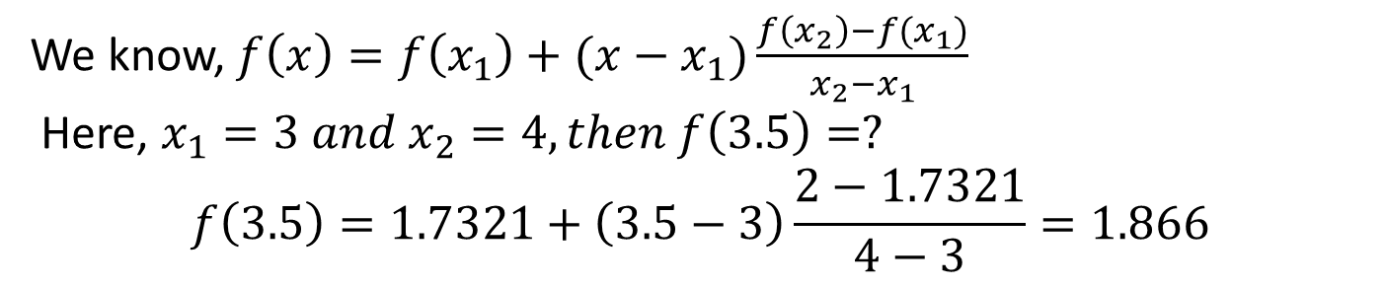
Linear Interpolation
From our previous example, determine the value of f(x) for x = 3.5, for the given tabular value
x
1
2
3
4
5
f(x)
1
1.4142
1.7321
2
2.2361
We know, $f\left(x\right)=f\left(x_{1}\right)+(x−x_{1})\frac{f\left(x_{2}\right)−f(x_{1})}{x_{2}−x_{1}}$
Here, $x_{1}=3 and x_{2}=4, then f\left(3.5\right)=?$
$$f\left(3.5\right)=1.7321+\left(3.5−3\right)\frac{2−1.7321}{4−3}=1.866$$
The accurate value is 1.8708, error= 1.8708-1.866=0.0048, so we need better (complicated?) interpolation functions for getting more accurate result

Slide 5
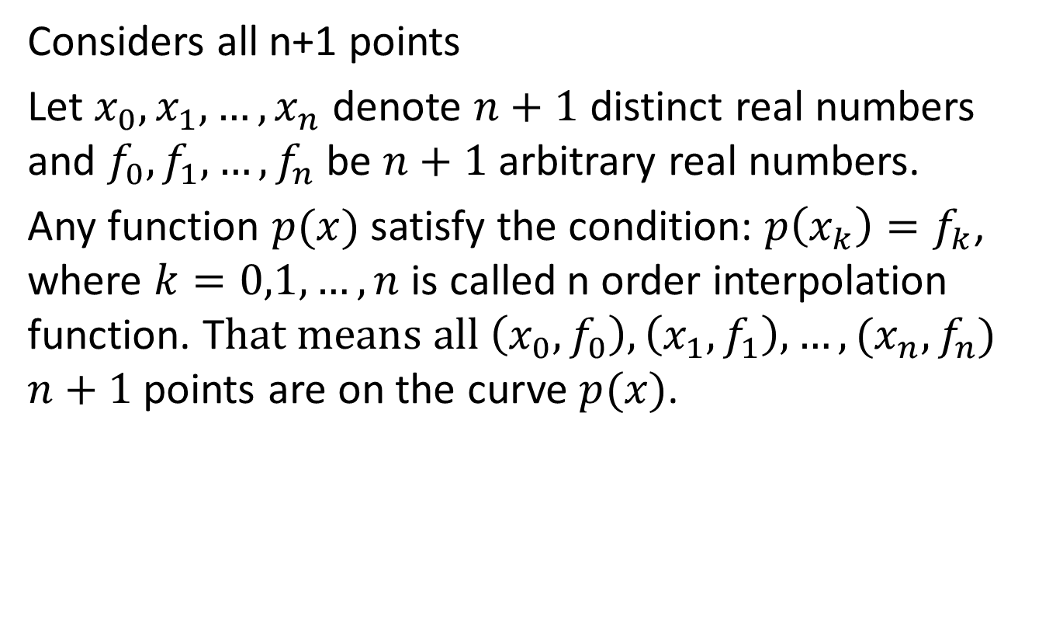
Lagrange Interpolation Polynomial
Considers all n+1 points
Let $x_{0},x_{1},…, x_{n}$ denote $n+1$ distinct real numbers and $f_{0},f_{1},…, f_{n}$ be $n+1$ arbitrary real numbers.
Any function $p(x)$ satisfy the condition: $p\left(x_{k}\right)=f_{k}$, where $k=0,1,…, n$ is called n order interpolation function. T$hat means all \left(x_{0},f_{0}\right), \left(x_{1},f_{1}\right),…,{(x}_{n},f_{n})$ $n+1$ points are on the curve $p(x)$.

Slide 6
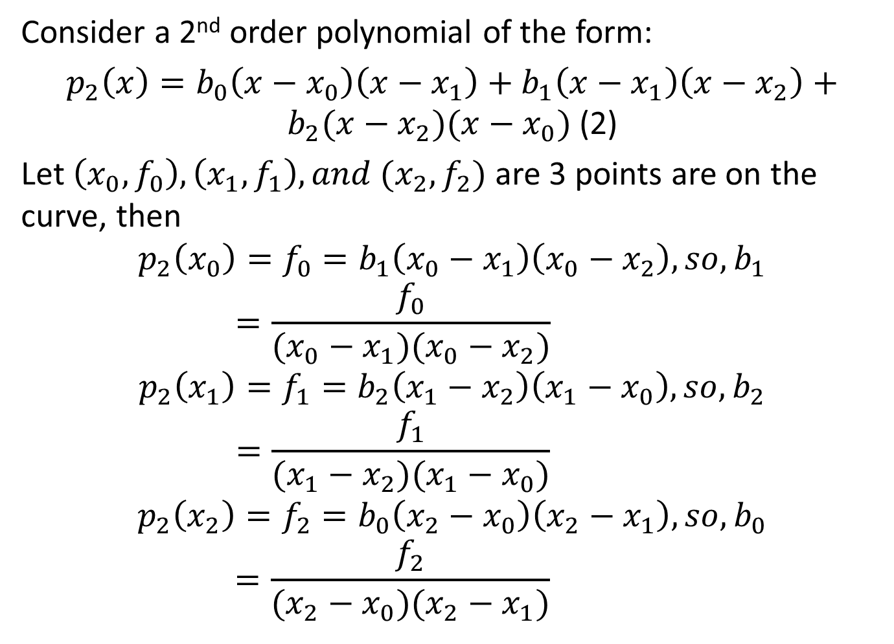
Lagrange Interpolation Polynomial
Consider a 2nd order polynomial of the form:
$p_{2}\left(x\right)=b_{0}\left(x−x_{0}\right)\left(x−x_{1}\right)+b_{1}\left(x−x_{1}\right)\left(x−x_{2}\right)+b_{2}(x−x_{2})(x−x_{0})$ (2)
Let $\left(x_{0},f_{0}\right),\left(x_{1},f_{1}\right), and (x_{2},f_{2})$ are 3 points are on the curve, then
$$p_{2}\left(x_{0}\right)=f_{0}=b_{1}\left(x_{0}−x_{1}\right)\left(x_{0}−x_{2}\right), so, b_{1}=\frac{f_{0}}{(x_{0}−x_{1})(x_{0}−x_{2})}$$
$$p_{2}\left(x_{1}\right)=f_{1}=b_{2}\left(x_{1}−x_{2}\right)\left(x_{1}−x_{0}\right), so, b_{2}=\frac{f_{1}}{(x_{1}−x_{2})(x_{1}−x_{0})}$$
$$p_{2}\left(x_{2}\right)=f_{2}=b_{0}\left(x_{2}−x_{0}\right)\left(x_{2}−x_{1}\right), so, b_{0}=\frac{f_{2}}{(x_{2}−x_{0})(x_{2}−x_{1})}$$

Slide 7
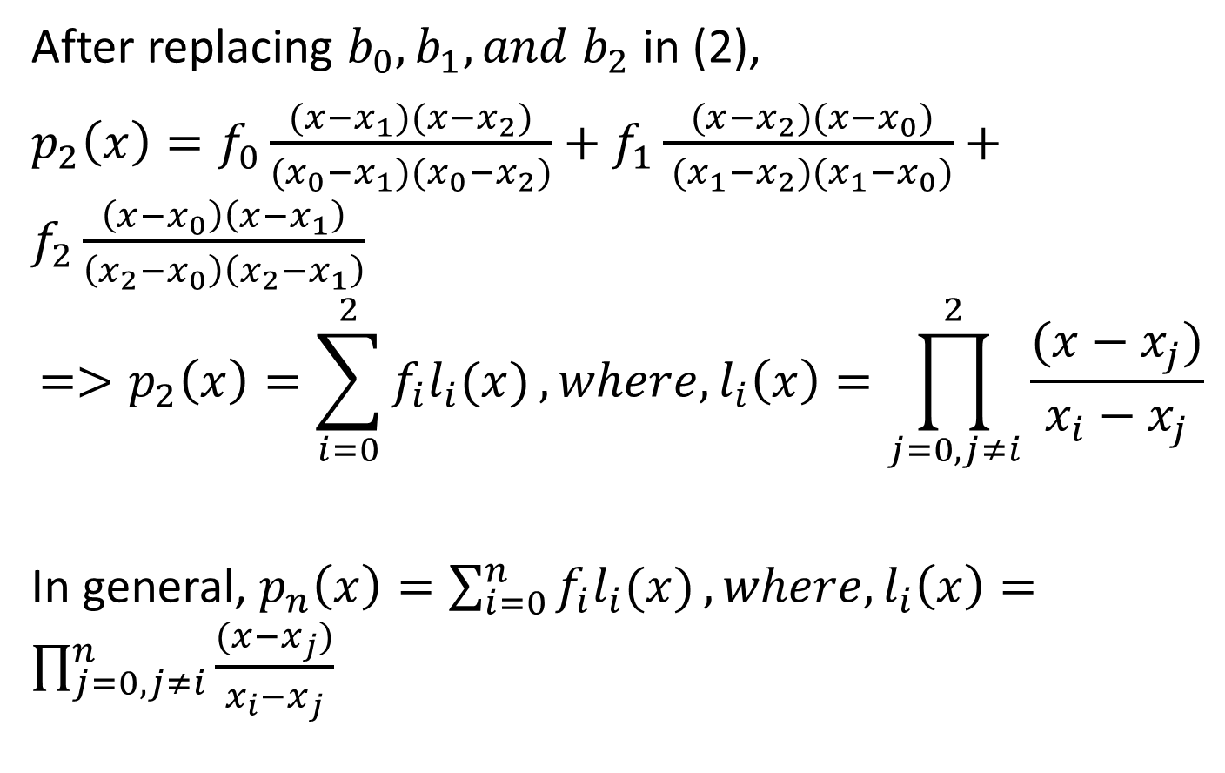
Lagrange Interpolation Polynomial
After replacing $b_{0},b_{1}, and b_{2}$ in (2),
$p_{2}\left(x\right)=f_{0}\frac{(x−x_{1})(x−x_{2})}{{(x}_{0}−x_{1})(x_{0}−x_{2})}+f_{1}\frac{ (x−x_{2})(x−x_{0})}{ (x_{1}−x_{2})(x_{1}−x_{0})}+f_{2}\frac{\left(x−x_{0}\right)\left(x−x_{1}\right)}{\left(x_{2}−x_{0}\right)\left(x_{2}−x_{1}\right)}$
$$=>p_{2}\left(x\right)=\sum_{i=0}^{2}{f_{i}l_{i}(x)}, where, l_{i}\left(x\right)=\prod_{j=0,j≠i}^{2}{\frac{(x−x_{j})}{x_{i}−x_{j}}}$$
In general, $p_{n}\left(x\right)=\sum_{i=0}^{n}{f_{i}l_{i}(x)},where,l_{i}\left(x\right)=\prod_{j=0,j≠i}^{n}{\frac{(x−x_{j})}{x_{i}−x_{j}}}$

Slide 8
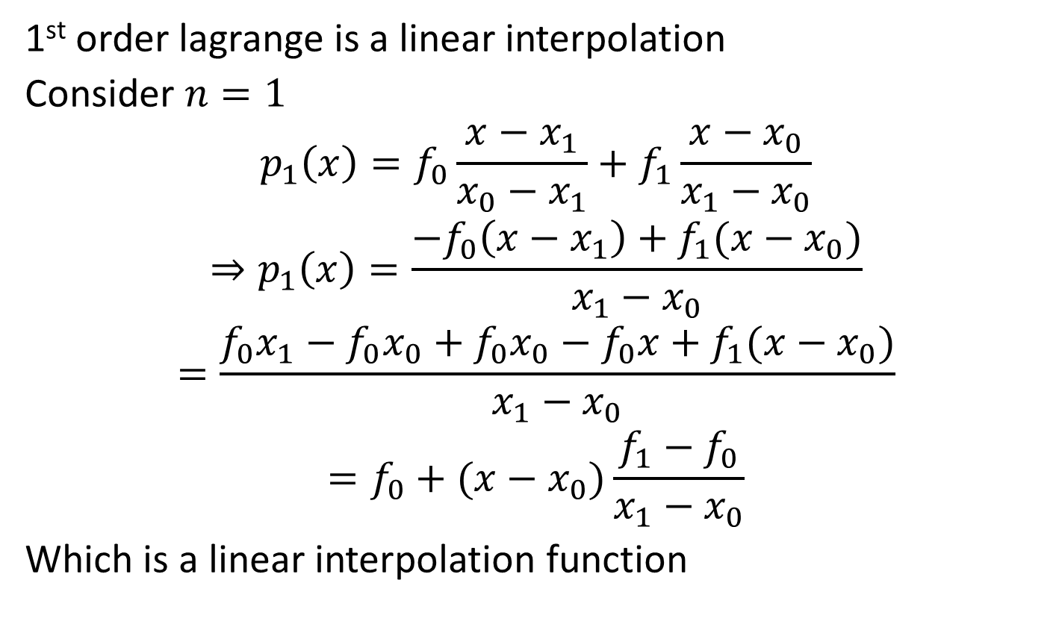
Lagrange VS. Linear interpolation
1st order lagrange is a linear interpolation
Consider $n=1$
$$p_{1}\left(x\right)=f_{0}\frac{x−x_{1}}{x_{0}−x_{1}}+f_{1}\frac{x−x_{0}}{x_{1}−x_{0}}$$
$$⇒p_{1}\left(x\right)=\frac{−f_{0}\left(x−x_{1}\right)+f_{1}(x−x_{0})}{x_{1}−x_{0}}$$
$$=\frac{f_{0}x_{1}−f_{0}x_{0}+f_{0}x_{0}−f_{0}x+f_{1}(x−x_{0})}{x_{1}−x_{0}}$$
$$=f_{0}+(x−x_{0})\frac{f_{1}−f_{0}}{x_{1}−x_{0}}$$
Which is a linear interpolation function

Slide 9
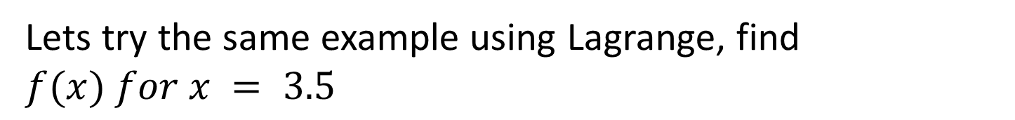
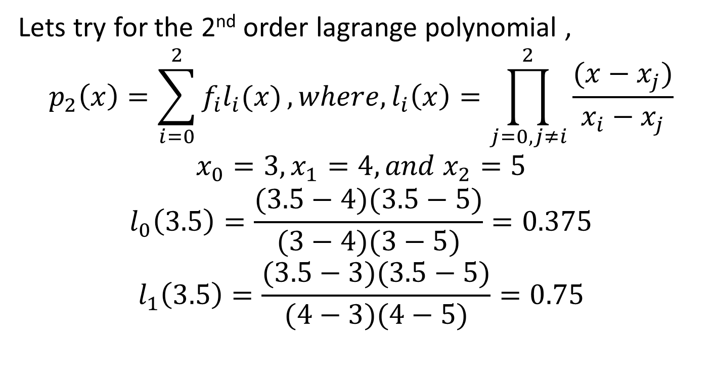
Lagrange Interpolation Polynomial
Lets try the same example using Lagrange, find $f(x) for x = 3.5$
x
1
2
3
4
5
f(x)
1
1.4142
1.7321
2
2.2361
Lets try for the 2nd order lagrange polynomial ,
$$p_{2}\left(x\right)=\sum_{i=0}^{2}{f_{i}l_{i}(x)}, where, l_{i}\left(x\right)=\prod_{j=0,j≠i}^{2}{\frac{(x−x_{j})}{x_{i}−x_{j}}}$$
$$x_{0}=3,x_{1}=4, and x_{2}=5$$
$$l_{0}\left(3.5\right)=\frac{(3.5−4)(3.5−5)}{(3−4)(3−5)}=0.375$$
$$l_{1}\left(3.5\right)=\frac{(3.5−3)(3.5−5)}{(4−3)(4−5)}=0.75$$

Slide 10
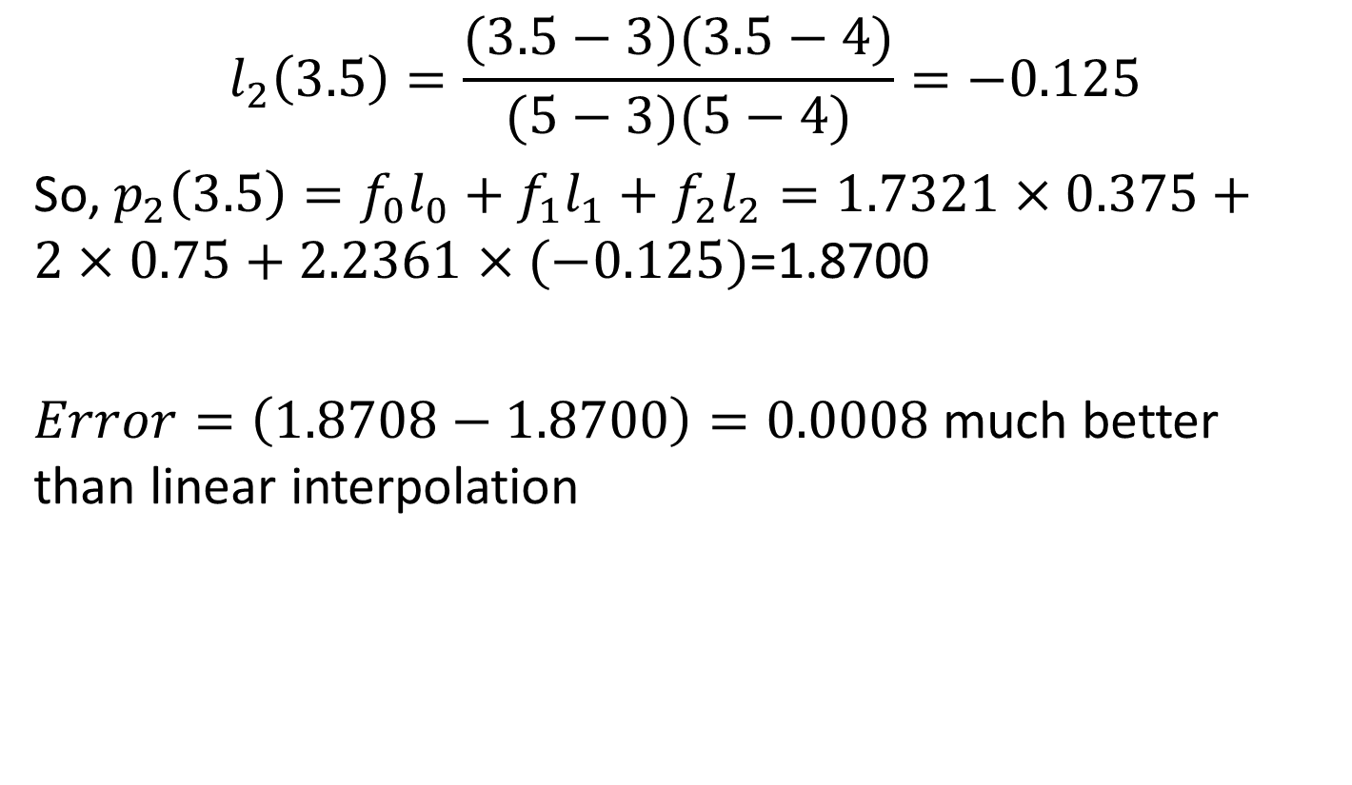
Lagrange Interpolation Polynomial
$$l_{2}\left(3.5\right)=\frac{(3.5−3)(3.5−4)}{(5−3)(5−4)}=−0.125$$
So, $p_{2}\left(3.5\right)=f_{0}l_{0}+f_{1}l_{1}+f_{2}l_{2}=1.7321×0.375+2×0.75+2.2361×(−0.125)$=1.8700
$Error=\left(1.8708−1.8700\right)=0.0008$ much better than linear interpolation

Slide 11
References
Numerical Methods by E Balagurusamy

